Slide 1


Veer Pal Singh
Data Scientist
28/11/2021

Slide 2

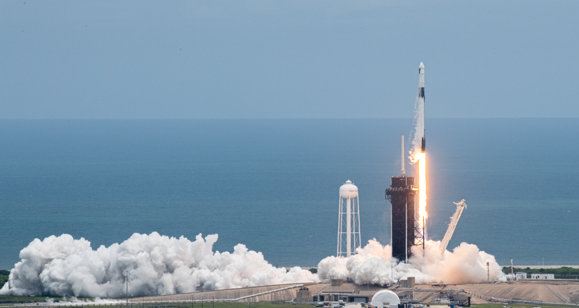
Outline
Executive Summary
Introduction
Methodology
Results
Conclusion
Appendix

Slide 3

Executive Summary
Summary of methodologies
Data Collection
Data Wrangling
EDA with Data Visualization
EDA with SQL
Building an Interactive map with Folium
Building a Dashboard with Plotly Dash
Predictive Analysis(Classification)
Summary of all results
Exploratory data analysis
Interactive analysis demo in screenshots
Predictive Analysis results

Slide 4

Introduction
Project background and context
We predicted if the Falcon 9 first stage will land successfully
SpaceX advertises Falcon 9 rocket launches on its website, with a cost of 65millon dollars; other providers cost upward of 165 million dollar, much of savings is because SpaceX can reuse the first stage will land,
Therefor, if we can determine if the first stage will land we can determine the cost of a launch, This information can be used if an alternative company wants to bid against SpaceX for a rocket launch
Problems that need to be solved?
What influences if the rocket will land successfully?
The effect each relationship with certain rocket variables will impact in determining the success rate of a successful landing
What conditions does SpaceX have to achieve to get the best results and ensure the best rocket success landing rate.

Slide 5


Slide 6

Methodology
Data collection methodology:
SpaceX REST API
Web Scraping from Wikipedia
Perform data wrangling
One Hot Encoding data fields for Machine Learning and dropping out irrelevant columns
Perform exploratory data analysis (EDA) using visualization and SQL
Plotting: scattered Graphs and Bar Graphs to show relationship between variables
Perform interactive visual analytics using Folium and Plotly Dash
Perform predictive analysis using classification models
How to build, how tuned, how evaluated the classification models

Slide 7


Data Collection
We worked with SpaceX launch data that is gathered from the SpaceX REST API.
This API will give us data about launches, including information about the rocket used, payload delivered, launch specifications, landing specifications, and landing outcome.
Our goal is to use this data to predict whether SpaceX will attempt to land a rocket or not.
The SpaceX REST API endpoints, or URL, starts with api.spacexdata.com/v4/.
Another popular data source for obtaining Falcon 9 Launch data is web scraping Wikipedia using BeautifulSoup.
Request HTML data from Wikipedia
Web Scrapping
SpaceX REST API
Extract data using Beautiful Soap
Use SpaceX
REST API
Return SpaceX data in .json file
Normalize .json data into .csv data
Normalize data into .csv file

Slide 8
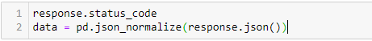
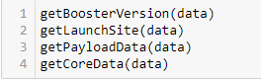
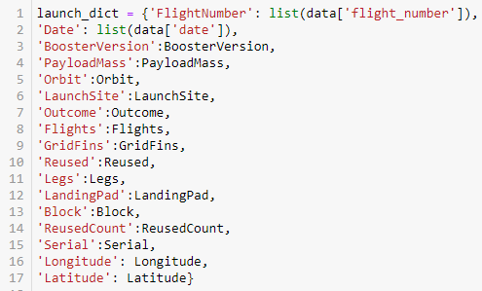

Data Collection – SpaceX API
Getting response from API
2. Converting Response to a .json file
3. Apply custom functions to clean data
4. Assign list to dictionary then dataframe
5. Filter dataframe and export to flat file in .csv
Data collection with SpaceX REST API
Use SpaceX REST API
API return SpaceX data in .json
Filter .json data into dataframe
Clean the data
Export data to flat .csv file
Add the GitHub URL: https://github.com/veer2701/github_projects/blob/main/IBM-Data-Science---SpaceX-Capstone-Project/1.1%20%20jupyter-labs-spacex-data-collection-api-OK-Final.ipynb

Slide 9

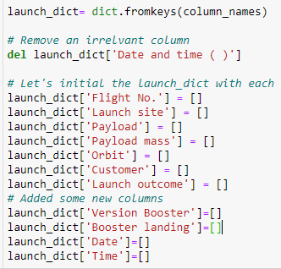

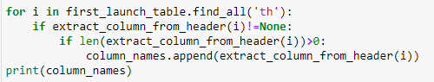

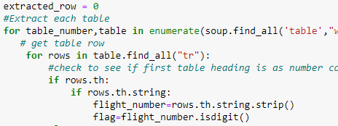

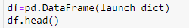
Data Collection – Web Scraping
1. Getting response from HTML
2. Creating BeautifulSoup Object
5. Creation of dictionary
Add the GitHub URL: https://github.com/veer2701/github_projects/blob/main/IBM-Data-Science---SpaceX-Capstone-Project/1.2%20%20jupyter-labs-webscraping-OK.ipynb
3. Finding Tables
4. Getting Column Names
6. Appending data to keys
7. Converting dictionary to dataframe
8. Dataframe to .csv file

Slide 10

Data Wrangling
Introduction
In the data set, there are several different cases where the booster did not land successfully. Sometimes a landing was attempted but failed due to an accident; for example, True Ocean means the mission outcome was successfully landed to a specific region of the ocean while False Ocean means the mission outcome was unsuccessfully landed to a specific region of the ocean. True RTLS means the mission outcome was successfully landed to a ground pad False RTLS means the mission outcome was unsuccessfully landed to a ground pad. True ASDS means the mission outcome was successfully landed on a drone ship False ASDS means the mission outcome was unsuccessfully landed on a drone ship. We mainly convert those outcomes into Training Labels with 1 means the booster successfully landed 0 means it was unsuccessful.
Each launch aims to an dedicated orbit, and here are some common orbit types:
Perform Exploratory Data Analysis EDA on dataset
Calculate the number of launches at each site
Calculate the number of occurrence of each orbit
Calculate the number and occurrence of mission outcome per orbit type
Export dataset as a .csv file
Create a landing outcome label from Outcome column
Work out success rate for every landing in dataset
GitHub URL: https://github.com/veer2701/github_projects/blob/main/IBM-Data-Science---SpaceX-Capstone-Project/1.3%20%20labs-jupyter-spacex-Data%20wrangling-OK.ipynb

Slide 11

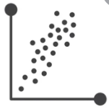

EDA with Data Visualization
Scatter Graphs being drawn:
Flight Number vs Payload Mass
Flight Number vs Launch Site
Payload Mass vs Launch Site
Orbit vs. Flight Number
Payload vs. Orbit Type
Orbit vs. Payload Mass
Add the GitHub URL: https://github.com/veer2701/github_projects/blob/main/IBM-Data-Science---SpaceX-Capstone-Project/2.2%20%20jupyter-labs-eda-dataviz-OK.ipynb
Bar Graph being drawn:
Mean vs. Orbit
A bar diagram makes it easy to compare sets of data between different groups at a glance. The graph represents categories on one axis and a discrete value in the other. The goal is to show the relationship between the two axes. Bar charts can also show big changes in data over time.
Line Graph being drawn:
Success rate vs. Year
Line graphs are useful in that they show data variables and trends very clearly and can help to make predictions about the results of data not yet recorded
Scatter plots show how much one variable is affected by another. The relationship between two variables is called their correlation . Scatter plots usually consist of a large body of data.

Slide 12

EDA with SQL
Performed SQL queries to gather information about the dataset
We needed the information about some questions that we were asked about data. For that we used SQL queries to get the answers in the dataset:
Displaying the names of the unique launch sites in the space mission
Displaying 5 records where launch sites begin with the string 'KSC’
Displaying the total payload mass carried by boosters launched by NASA (CRS)
Displaying average payload mass carried by booster version F9 v1.1
Listing the date where the successful landing outcome in drone ship was achieved.
Listing the names of the boosters which have success in ground pad and have payload mass greater than 4000 but less than 6000
Listing the total number of successful and failure mission outcomes
Listing the names of the booster versions which have carried the maximum payload mass.
Listing the records which will display the month names, successful landing outcomes in ground pad ,booster versions, launch site for the months in year 2017
Ranking the count of successful landing outcomes between the date 2010-06-04 and 2017-03-20 in descending order.
GitHub url: https://github.com/veer2701/github_projects/blob/main/IBM-Data-Science---SpaceX-Capstone-Project/2.1%20%20jupyter-labs-eda-sql-coursera_OK.ipynb

Slide 13
Build an Interactive Map with Folium
To visualize the Launch Data into an interactive map. We took the Latitude and Longitude Coordinates at each launch site and added a Circle Marker around each launch site with a label of the name of the launch site.
We assigned the dataframe launch_outcomes(failures, successes) to classes 0 and 1 with Green and Red markers on the map in a MarkerCluster()
Using Haversine's formula we calculated the distance from the Launch Site to various landmarks to find various trends about what is around the Launch Site to measure patterns. Lines are drawn on the map to measure distance to landmarks
Example of some trends in which the Launch Site is situated in.
Are launch sites in close proximity to railways? No
Are launch sites in close proximity to highways? No
Are launch sites in close proximity to coastline? Yes
Do launch sites keep certain distance away from cities? Yes
Add the GitHub URL https://github.com/veer2701/github_projects/blob/main/IBM-Data-Science---SpaceX-Capstone-Project/3.1%20%20%20lab_jupyter_launch_site_location-OK.ipynb

Slide 14
Build a Dashboard with Plotly Dash
Used Python to host the website so your can play around with the data and view the data
The dashboard is built with Plotly and Dash web framework.
Graphs
- Pie Chart showing the total launches by a certain site/all sites
- display relative proportions of multiple classes of data.
- size of the circle can be made proportional to the total quantity it represents.
Scatter Graph showing the relationship with Outcome and Payload Mass (Kg) for the different Booster Versions
It shows the relationship between two variables.
It is the best method to show you a non-linear pattern.
The range of data flow, i.e. maximum and minimum value, can be determined.
Observation and reading are straightforward.
Add the GitHub URL:
https://github.com/veer2701/github_projects/blob/main/IBM-Data-Science---SpaceX-Capstone-Project/3.2%20%20Data%20Visualization%20with%20Python.py

Slide 15

Predictive Analysis (Classification)
Building Model
Load our dataset into NumPy and Pandas
Transform Data
Split our data into training and test data sets
Check how many test samples we have
Decide which type of machine learning algorithms we want to use
Set our parameters and algorithms to GridSearchCV
Fit our datasets into the GridSearchCV objects and train our dataset.
Evaluating Model
Check accuracy for each model
Get tuned hyperparameters for each type of algorithms
Plot Confusion Matrix
Improving Model
Check accuracy for each model
Get tuned hyperparameters for each type of algorithms
Plot Confusion Matrix
Finding the best performing Classification model
Check accuracy for each model
Get tuned hyperparameters for each type of algorithms
Plot Confusion Matrix
Add the GitHub URL https://github.com/veer2701/github_projects/blob/main/IBM-Data-Science---SpaceX-Capstone-Project/4%20%20SpaceX_Machine%20Learning%20Prediction_Part_5-OK-Final.ipynb

Slide 16

Results
Exploratory data analysis results
Interactive analytics demo in screenshots
Predictive analysis results

Slide 17


Slide 18
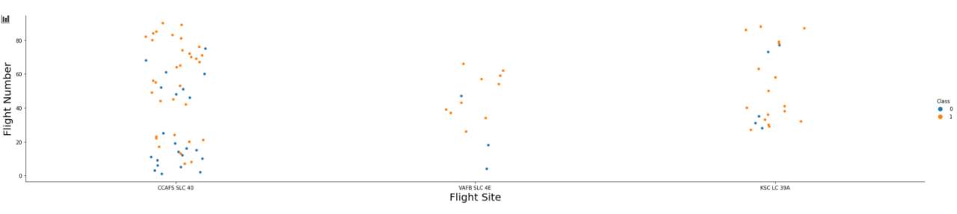
Flight Number vs. Launch Site
The more amount of flights at a launch site the greater the success rate at a launch site.

Slide 19
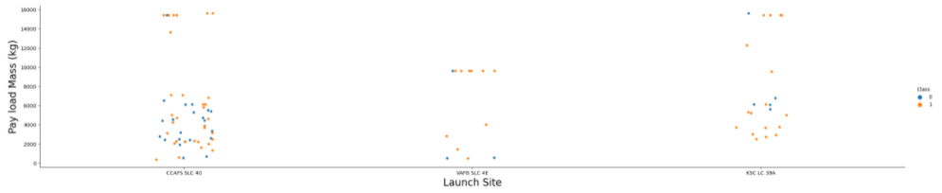
Payload vs. Launch Site
The greater the payload mass for Launch Site CCAFS SLC 40 the higher the success rate for the Rocket. There is not quite a clear pattern to be found using this visualization to make a decision if the Launch Site is dependent on Pay Load Mass for a success launch

Slide 20
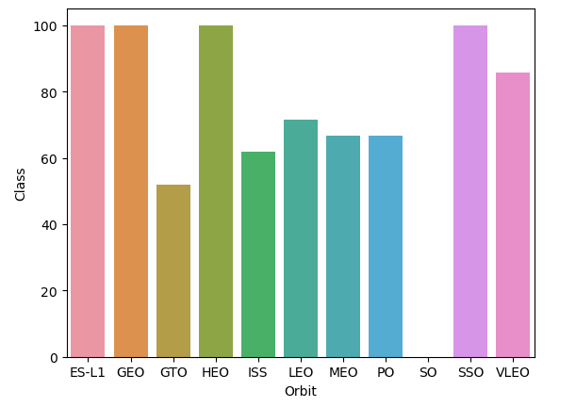
Success Rate vs. Orbit Type
Bar chart for the success rate of each orbit type
Orbit GEO, HEO, SSO, ES-L1 has the best Success Rate

Slide 21
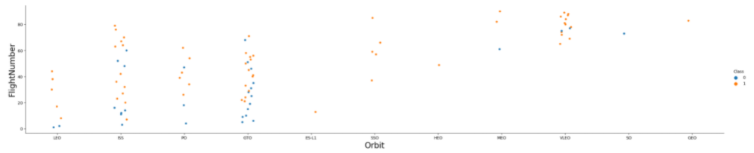
Flight Number vs. Orbit Type
You should see that in the LEO orbit the Success appears related to the number of flights; on the other hand, there seems to be no relationship between flight number when in GTO orbit.

Slide 22
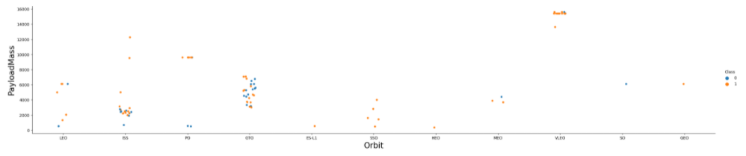
Payload vs. Orbit Type
You can observe that Heavy payloads have a negative influence on GTO orbits and positive on GTO and Polar LEO (ISS) orbits.

Slide 23
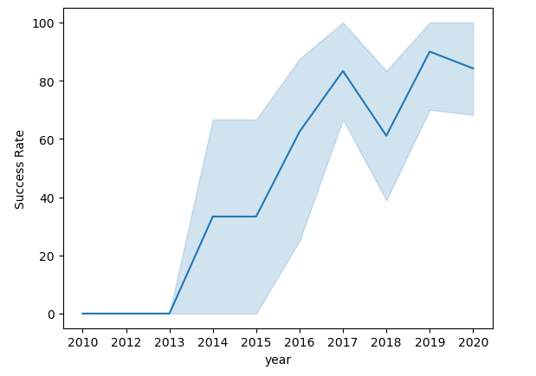
Launch Success Yearly Trend
Line chart of yearly average success rate
You can observe that the success rate since 2013 kept increasing till 2020

Slide 24
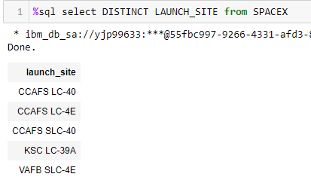
All Launch Site Names
SQL Query:
%sql select DISTINCT LAUNCH_SITE from SPACEX
Query Explanation:
Using the word DISTINCT in the query means that it will only show Unique values in the Launch_Site column from SpaceX

Slide 25
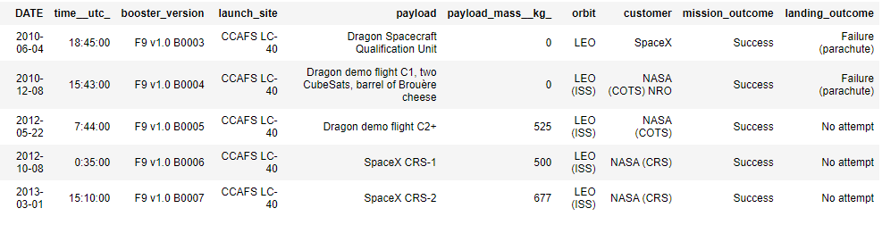
Launch Site Names Begin with 'CCA'
SQL Query:
%sql select * from SPACEX where launch_site like 'CCA%' limit 5
Query Explanation:
First five entries in database with Launch Site name beginning with CCA.

Slide 26
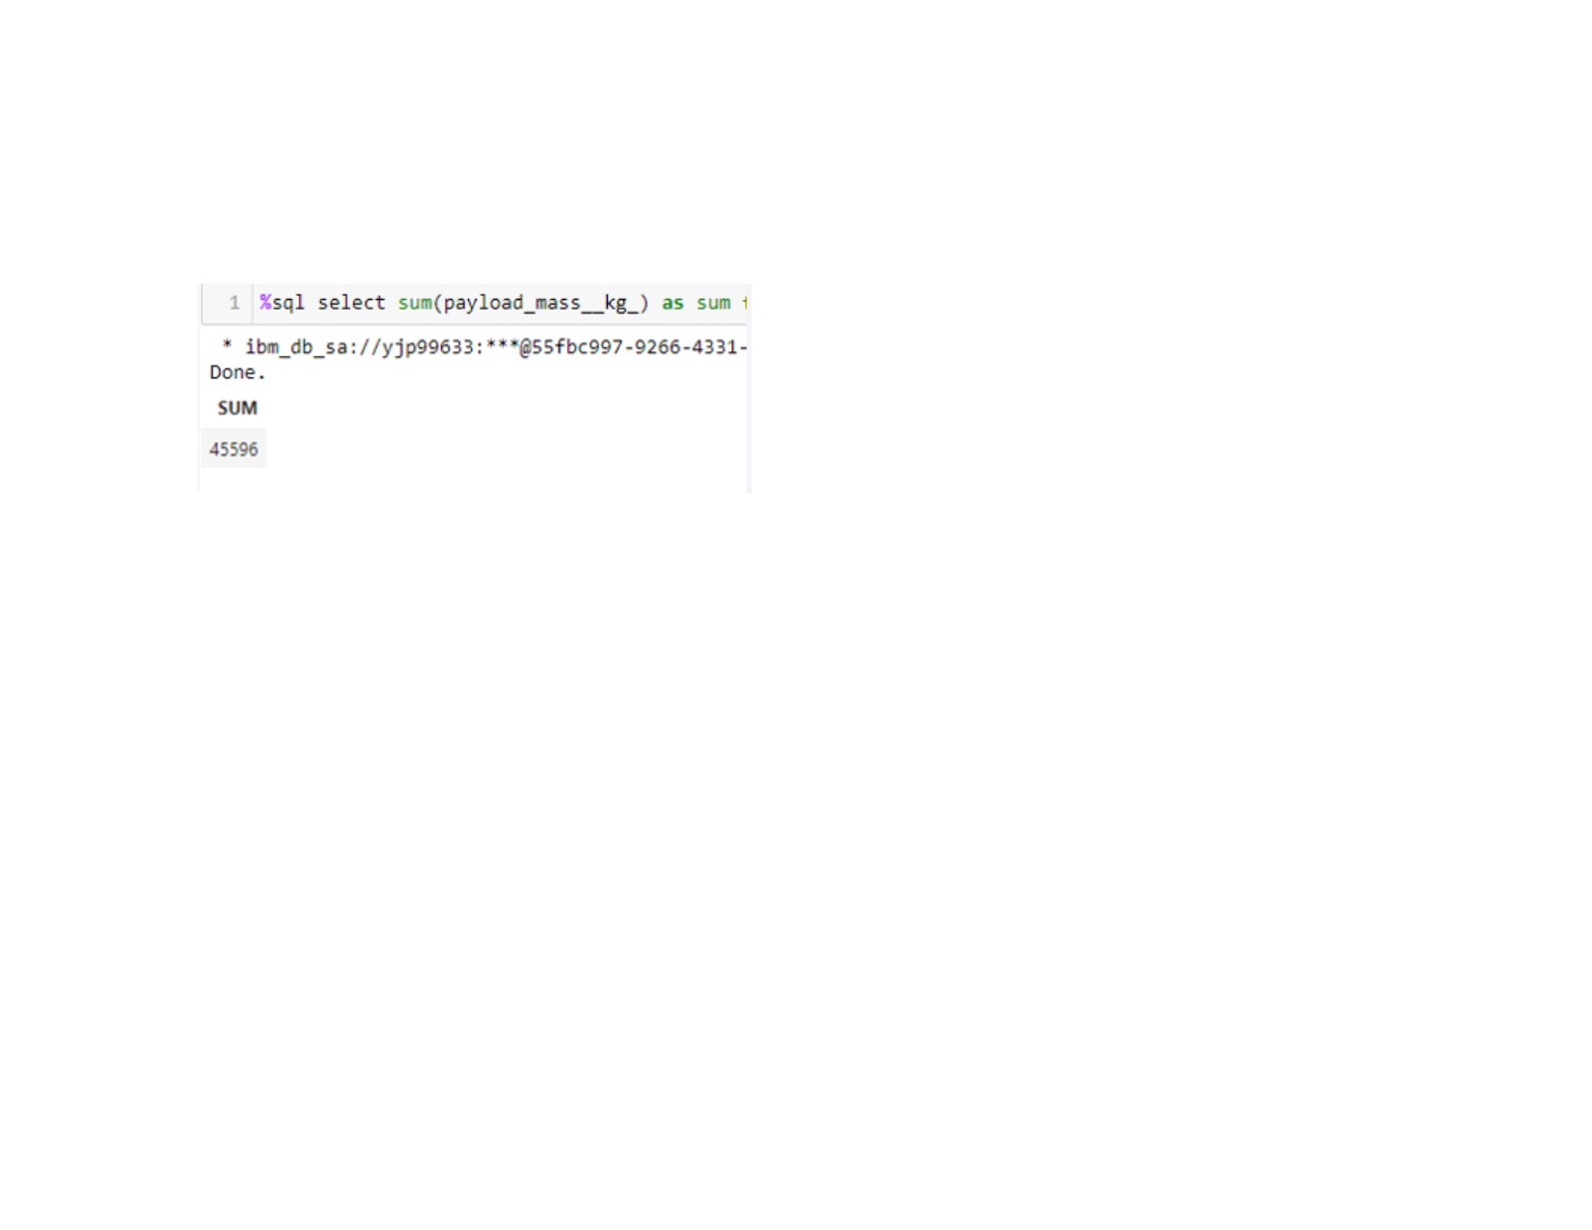
Total Payload Mass
SQL Query:
%sql select sum(payload_mass__kg_) as sum from SPACEX where customer like 'NASA (CRS)'
Query Explanation:
This query sums the total payload mass in kg where NASA was the customer.
CRS stands for Commercial Resupply Services which indicates that these payloads were sent to the International Space Station (ISS).

Slide 27
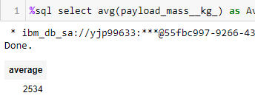
Average Payload Mass by F9 v1.1
SQL Query:
%sql select avg(payload_mass__kg_) as Average from SPACEX where booster_version like 'F9 v1.1%'
Query Explanation:
This query calculates the average payload mass or launches which used booster version F9 v1.1
Average payload mass of F9 1.1 is on the low end of our payload mass range

Slide 28
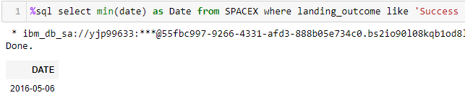
First Successful Ground Landing Date
SQL Query:
%sql select min(date) as Date from SPACEX where mission_outcome like 'Success'
Query Explanation:
Using the function MIN works out the minimum date in the column Date
The WHERE clause filters the dataset to only perform calculations on Landing_Outcome Success (drone ship)

Slide 29
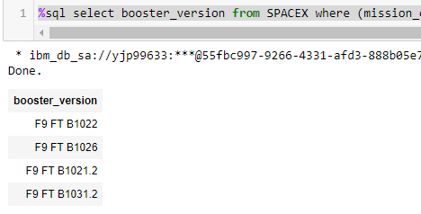
Successful Drone Ship Landing with Payload between 4000 and 6000
SQL Query:
%sql select booster_version from SPACEX where (mission_outcome like 'Success') AND (payload_mass__kg_ BETWEEN 4000 AND 6000) AND (landing_outcome like 'Success (drone ship)')
Query Explanation:
Selecting only Booster_Version
The WHERE clause filters the dataset to Landing_Outcome = Success (drone ship)
The AND clause specifies additional filter conditions Payload_MASS_KG_ > 4000 AND Payload_MASS_KG_ < 6000

Slide 30
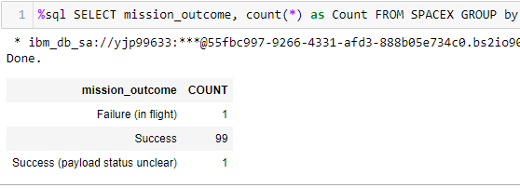
Total Number of Successful and Failure Mission Outcomes
SQL Query:
%sql SELECT mission_outcome, count(*) as Count FROM SPACEX GROUP by mission_outcome ORDER BY mission_outcome
Query Explanation:
This query returns a count of each mission outcome.
SpaceX appears to achieve its mission outcome nearly 99%
of the time.
This means that most of the landing failures are intended.
Interestingly, one launch has an unclear payload status and unfortunately one failed in flight.

Slide 31
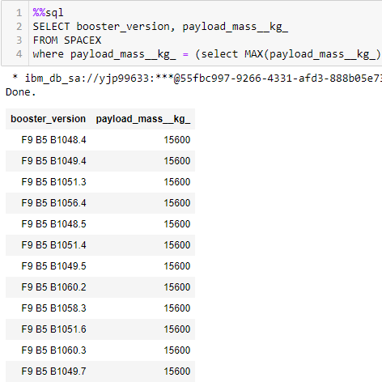
Boosters Carried Maximum Payload
SQL Query:
%sql SELECT DISTINCT booster_version, MAX(payload_mass__kg_) as MaximumPayloadMass FROM SPACEX GROUP BY booster_version
Query Explanation:
Using the word DISTINCT in the query means that it will only show Unique values in the Booster_Version column from SpaceX
GROUP BY puts the list in order set to a certain condition. DESC means its arranging the dataset into descending order

Slide 32
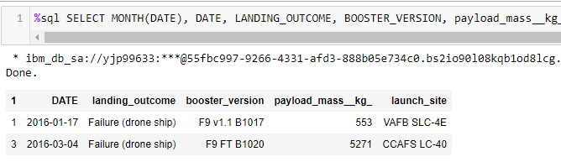
2016 Launch Records
SQL Query:
%sql SELECT MONTH(DATE), DATE, LANDING_OUTCOME, BOOSTER_VERSION, LAUNCH_SITE FROM SPACEX where LANDING_OUTCOME like 'Failure (drone ship)';
Query Explanation:
This query returns the Month, Landing Outcome, Booster Version, Payload Mass (kg), and Launch site of 2016 launches where stage 1 failed to land on a drone ship.
There were two such occurrences.

Slide 33
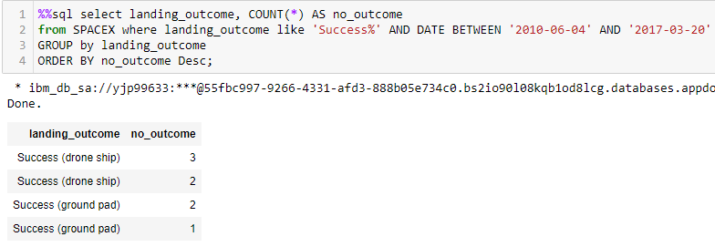
Rank Landing Outcomes Between 2010-06-04 and 2017-03-20
SQL Query:
%%sql select landing_outcome, COUNT(*) AS no_outcome
from SPACEX where landing_outcome like 'Success%' AND DATE BETWEEN '2010-06-04' AND '2017-03-20'
GROUP by landing_outcome
ORDER BY no_outcome Desc;
Query Explanation:
This query returns a list of successful landings and between 2010-06-04 and 2017-03-20 inclusively.
There are two types of successful landing outcomes: drone ship and ground pad landings.
There were 8 successful landings in total during this time period

Slide 34


Slide 35
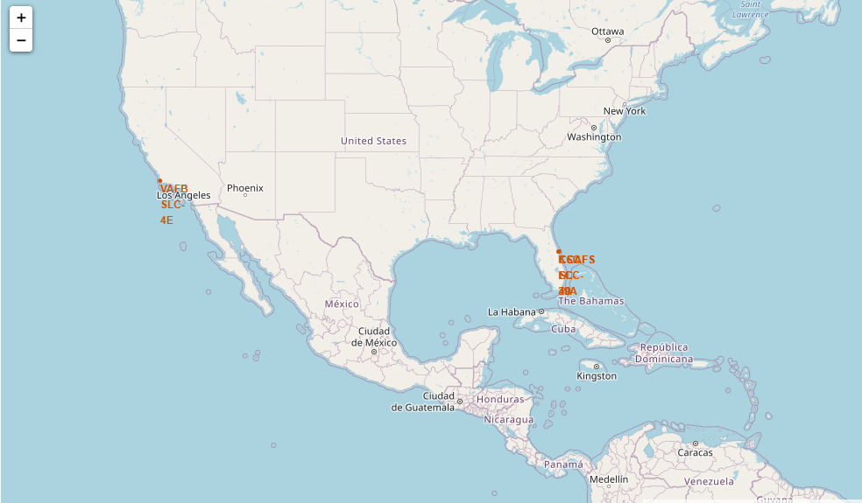
All launch sites map markers
We can see that the SpaceX launch sites are in the United States of America coasts, Florida and California.

Slide 36
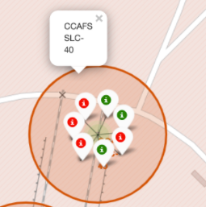
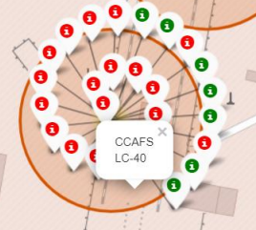
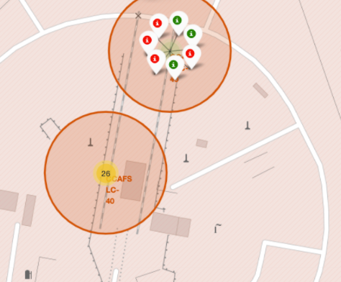
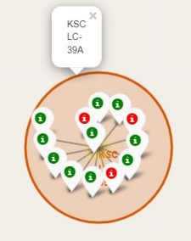
Color Labelled Markers
Florida Launch Sites
Green Marker shows successful launches
Red Marker shows unsuccessful launches

Slide 37
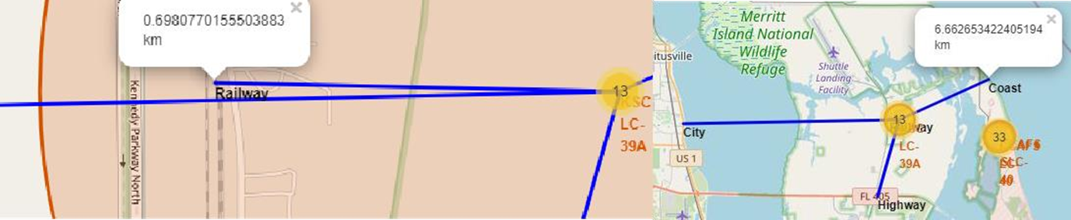
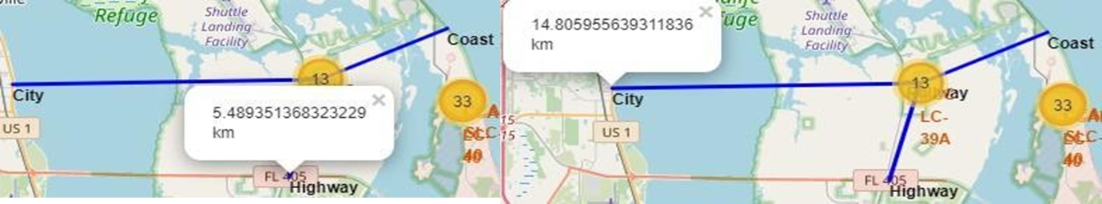
Working out Launch sites distances to landmarks to find the trends with Haversine formula using CCAFS-SLC-40 as a reference
Are launch sites in close proximity to railways? No
Are launch sites in close proximity to highways? No
Are launch sites in close proximity to coastline? Yes
Do launch sites keep certain distance away from cities? Yes

Slide 38


Slide 39
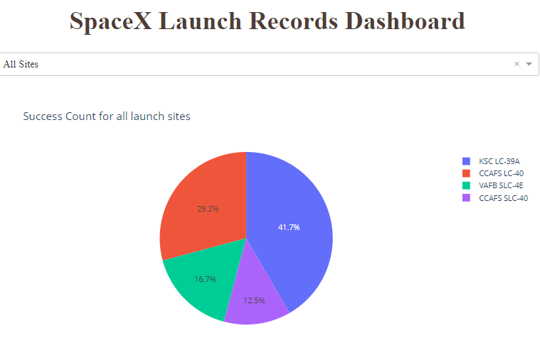
Dashboard – Pie Chart showing the success percentage achieved by each launch site
We can see that KSC LC-39A had the most successful launches from all the sites

Slide 40
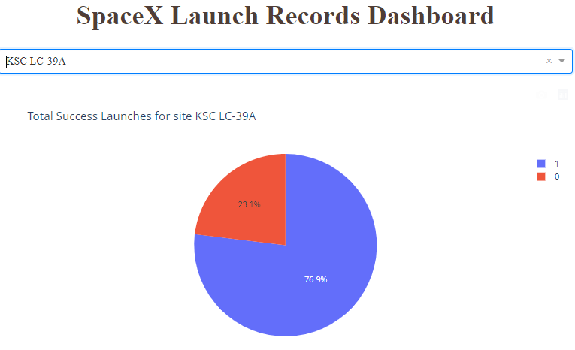
Dashboard – Pie Chart for the launch site with heist launch success ratio
KSC LC-39A achieved a 76.9% success rate while getting a 23.1% failure rate

Slide 41
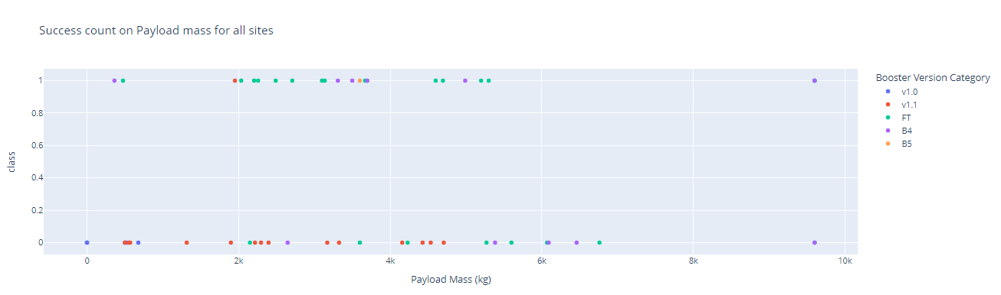
Dashboard – Payload vs. Launch Outcome scatter plot for all sites, with different payload selected in the range slider
We can see the success rates for low weighted payloads is higher than the heavy weighted payloads

Slide 42


Slide 43
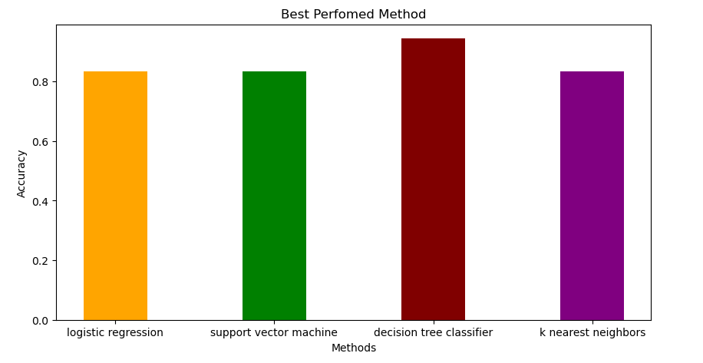
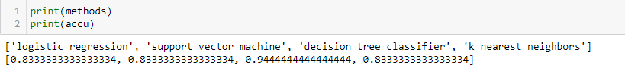
Classification Accuracy
Classification Accuracy using training data
As you can see our accuracy is extremely close but we do have a winner its down to decimal places! using this function
The Tree algorithm wins!!
After selecting the best hyperparameters for the decision tree classifier using the validation data, we achieved 94.44% accuracy on the test data.

Slide 44
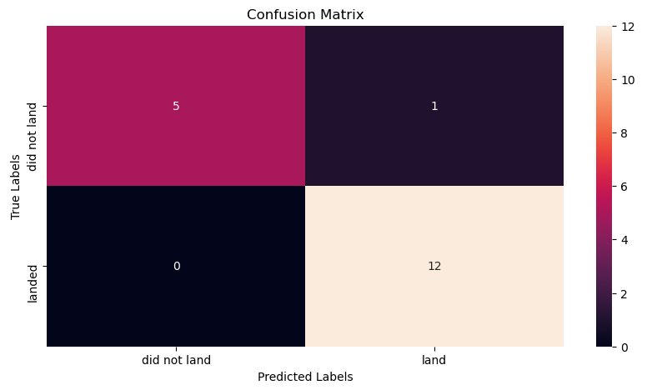
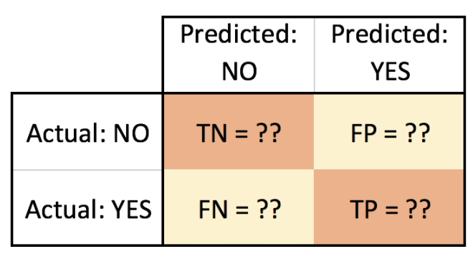
Confusion Matrix
Examining the confusion matrix, we see that Tree can distinguish between the different classes. We see that the major problem is false positives.
Confusion matrix for Tree Algorithm

Slide 45

Conclusions
Tree Classifier Algorithm is the best for Machine Learning Model
Low weighted payloads perform better than the heavier payloads
The success rates for SpaceX launches is directly proportional to time in years they will eventually perfect the launches
KSC LC-39A has the most successful launches from all Launch Sites
Orbit GEO, HEO, SSO, ES-L1 has best success rate

Slide 46
Appendix
Python Anywhere
Haversine Formula
Folium Maps
Coursera
IBM Watson Server
IBM Db2 Server
All Instructors from IBM
Github

Slide 47
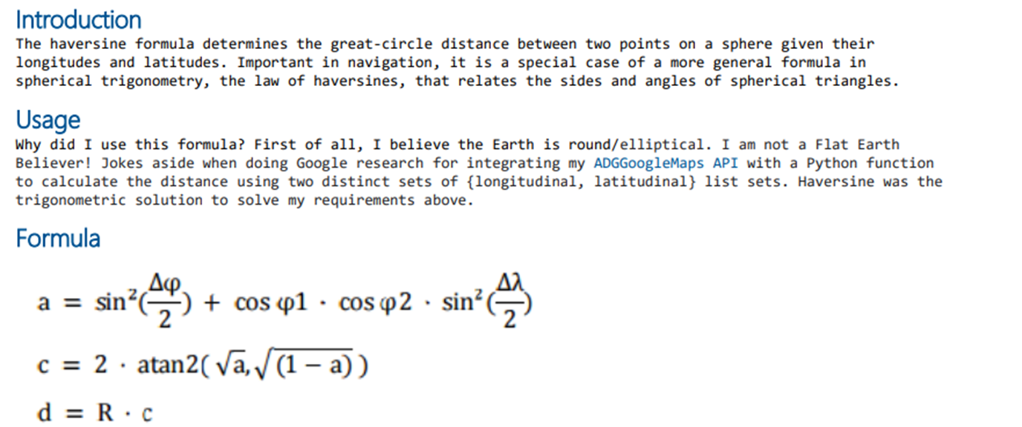
Appendix

Slide 48


